Slide 1
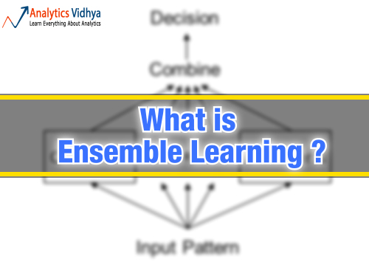

Slide 2
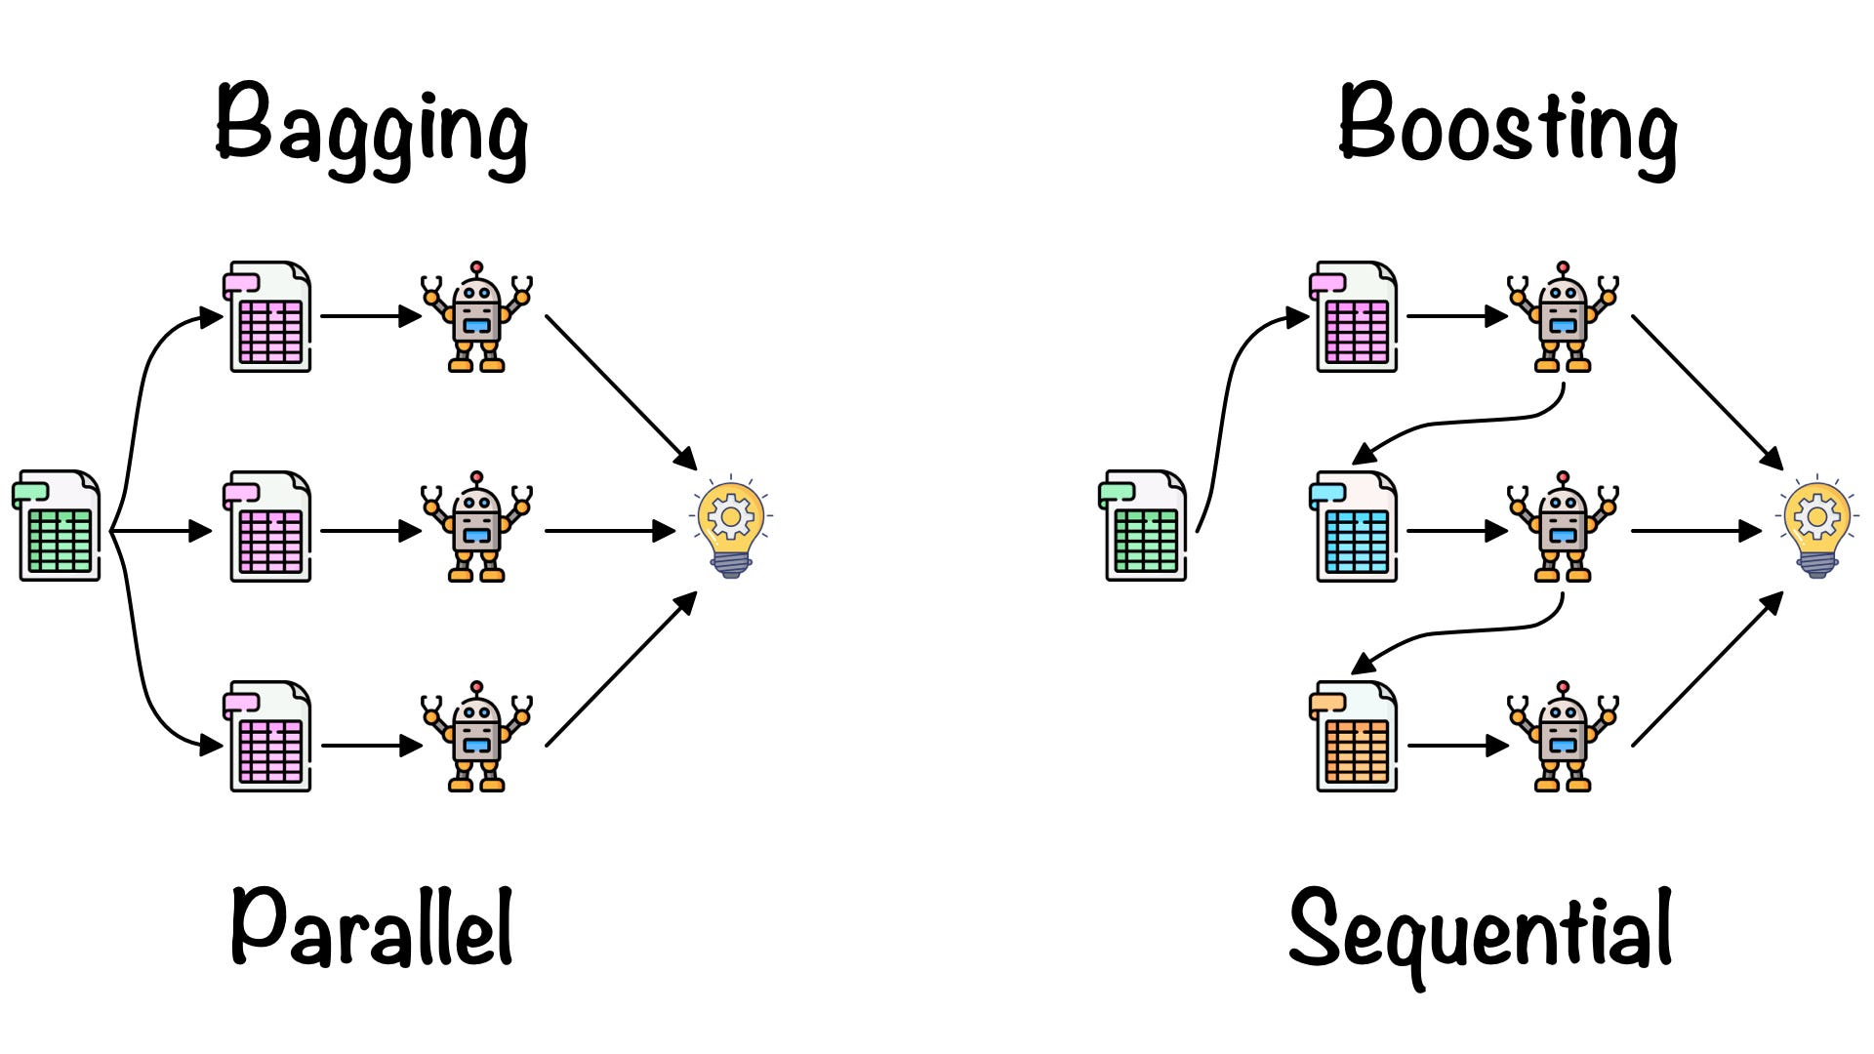

Slide 3
XGBOOST Model

Slide 4
Imagine that you are a hiring manager interviewing several candidates with excellent qualifications. Each step of the evolution of tree-based algorithms can be viewed as a version of the interview process.

Slide 5
Decision Tree: Every hiring manager has a set of criteria such as education level, number of years of experience, interview performance. A decision tree is analogous to a hiring manager interviewing candidates based on his or her own criteria.
Bagging: Now imagine instead of a single interviewer, now there is an interview panel where each interviewer has a vote. Bagging or bootstrap aggregating involves combining inputs from all interviewers for the final decision through a democratic voting process.

Slide 6
Random Forest: It is a bagging-based algorithm with a key difference wherein only a subset of features is selected at random. In other words, every interviewer will only test the interviewee on certain randomly selected qualifications (e.g. a technical interview for testing programming skills and a behavioral interview for evaluating non-technical skills).
Boosting: This is an alternative approach where each interviewer alters the evaluation criteria based on feedback from the previous interviewer. This ‘boosts’ the efficiency of the interview process by deploying a more dynamic evaluation process.

Slide 7
Gradient Boosting: A special case of boosting where errors are minimized by gradient descent algorithm e.g. the strategy consulting firms leverage by using case interviews to weed out less qualified candidates.
XGBoost: Think of XGBoost as gradient boosting on ‘steroids’ (well it is called ‘Extreme Gradient Boosting’ for a reason!). It is a perfect combination of software and hardware optimization techniques to yield superior results using less computing resources in the shortest amount of time.

Slide 8
Why does XGBoost perform so well?
XGBoost and Gradient Boosting Machines (GBMs) are both ensemble tree methods that apply the principle of boosting weak learners (CARTs generally) using the gradient descent architecture. However, XGBoost improves upon the base GBM framework through systems optimization and algorithmic enhancements.

Slide 9
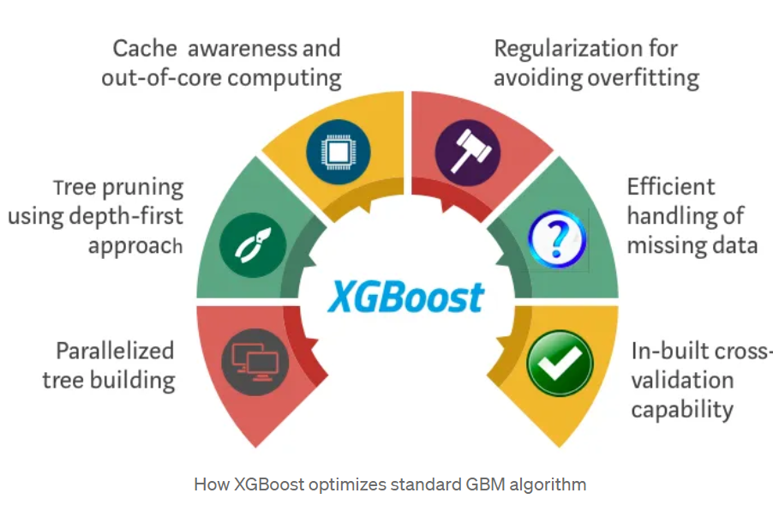

Slide 10
Where is the proof?
We used Scikit-learn’s ‘Make_Classification’ data package to create a random sample of 1 million data points with 20 features (2 informative and 2 redundant). We tested several algorithms such as Logistic Regression, Random Forest, standard Gradient Boosting, and XGBoost.

Slide 11
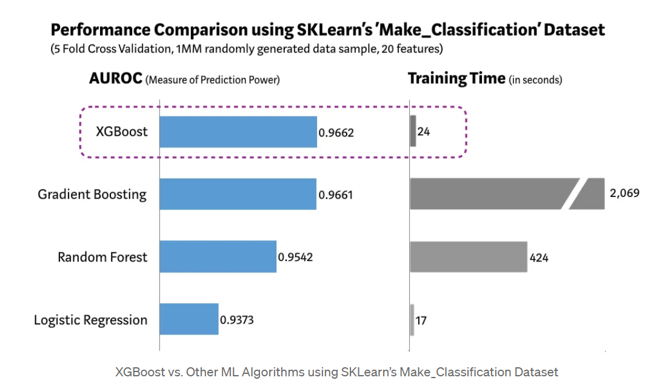

Slide 12
Advantages of XGBoost:
Performance: XGBoost has a strong track record of producing high-quality results in various machine learning tasks.
Scalability: designed for efficient, scalable training of machine learning models, making it suitable for large datasets.
Customizability: has a wide range of hyper parameters that can be adjusted to optimize performance, making it highly customizable.
Handling of Missing Values: support for handling missing values, making it easy to work with real-world data that often has missing values.
Interpretability: Unlike some machine learning algorithms that can be difficult to interpret, XGBoost provides feature importances, allowing for a better understanding of which variables are most important in making predictions.

